Slide 1

Chad Chess
By Steven Cisneros, Roger Hannigan, Andy Thai, Miles Blaisus, Badr Hashmi

Slide 2
Chad Game Overview
Objective: Capture opponent’s King
Both players’ start off with one King and 8 Rooks
Rooks are promoted to Queens once they end move inside Castle
No pieces may be captured outside of the castle (may only block)
King’s are restricted to 3x3 space inside castle
Kings in Chad inherit from King and Knight movement in Chess

Slide 3
Design Document
Package Diagram
Updated Design Class Diagram
Updated Sequence diagrams

Slide 4
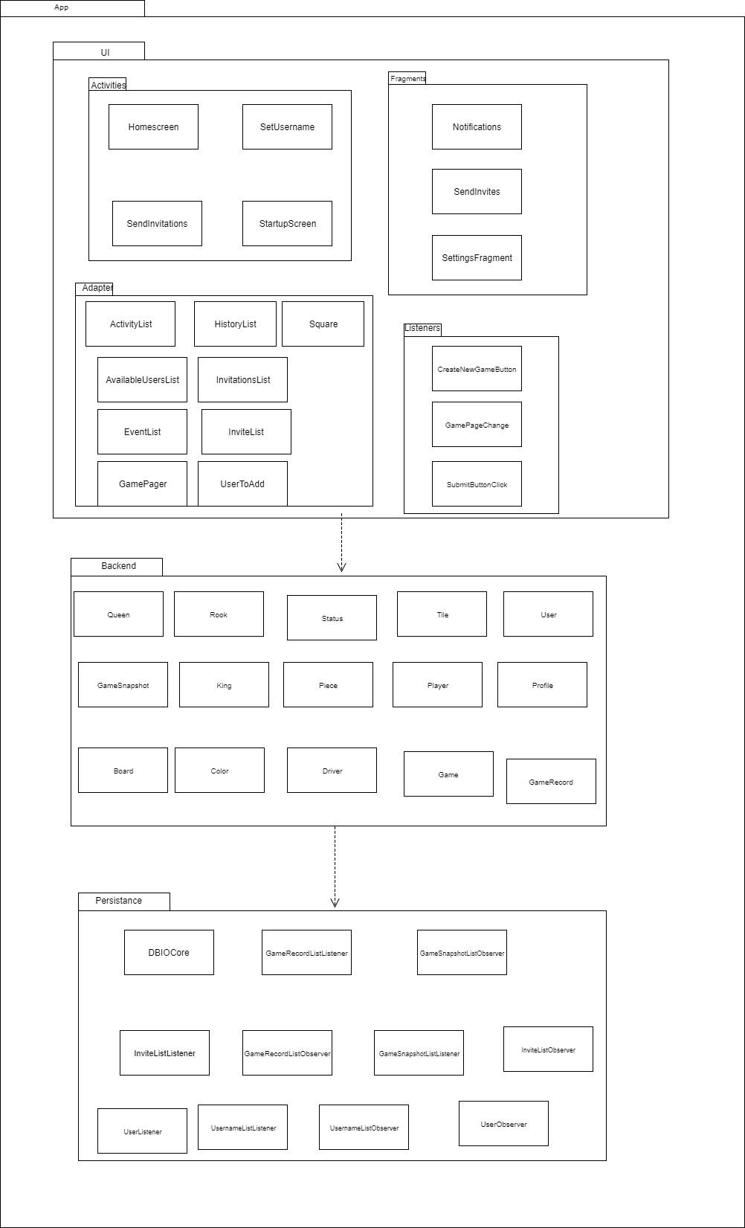
Package Diagram

Slide 5
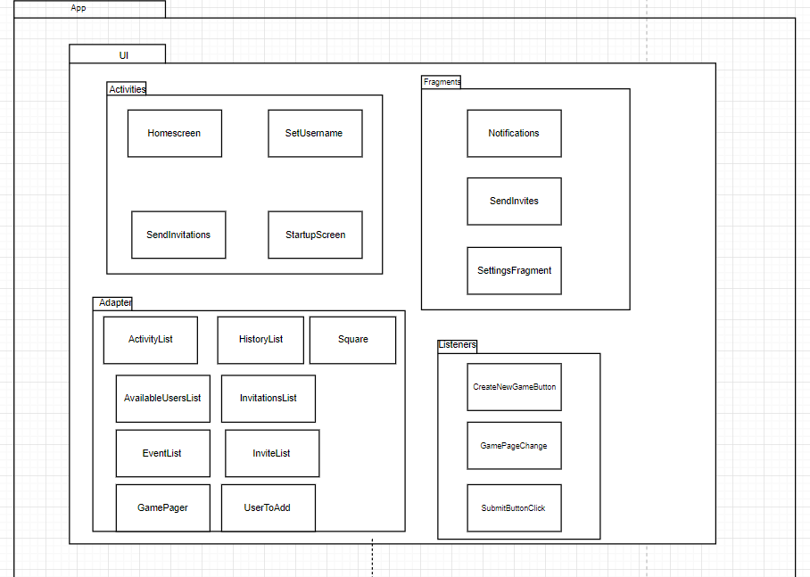
Package Diagram
Pt 1

Slide 6
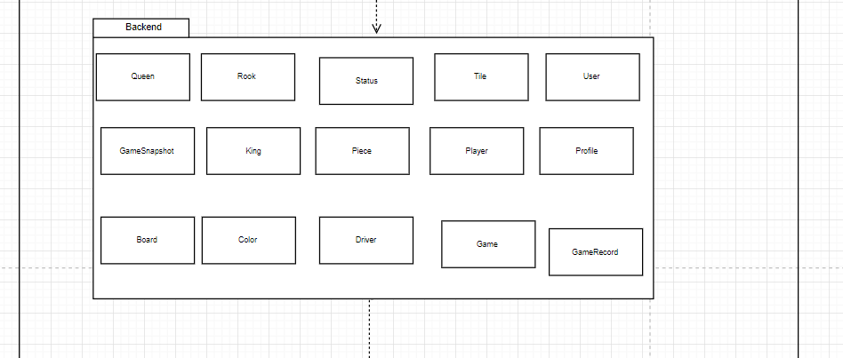
Package Diagram
Pt 2

Slide 7
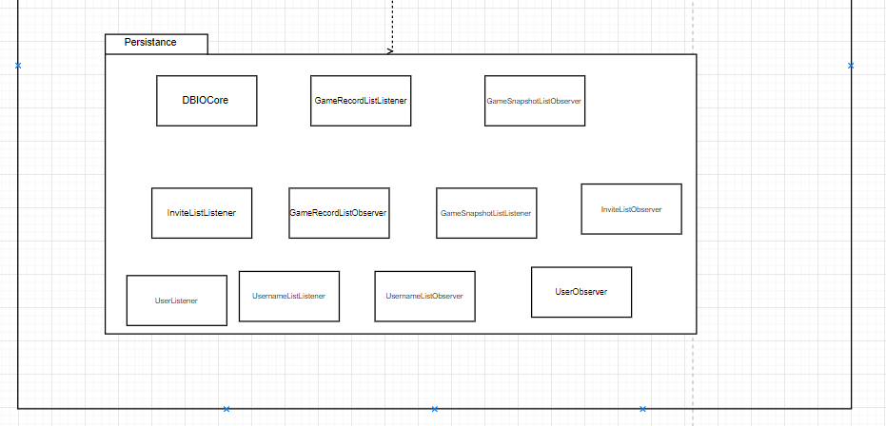
Package Diagram
Pt 3

Slide 8
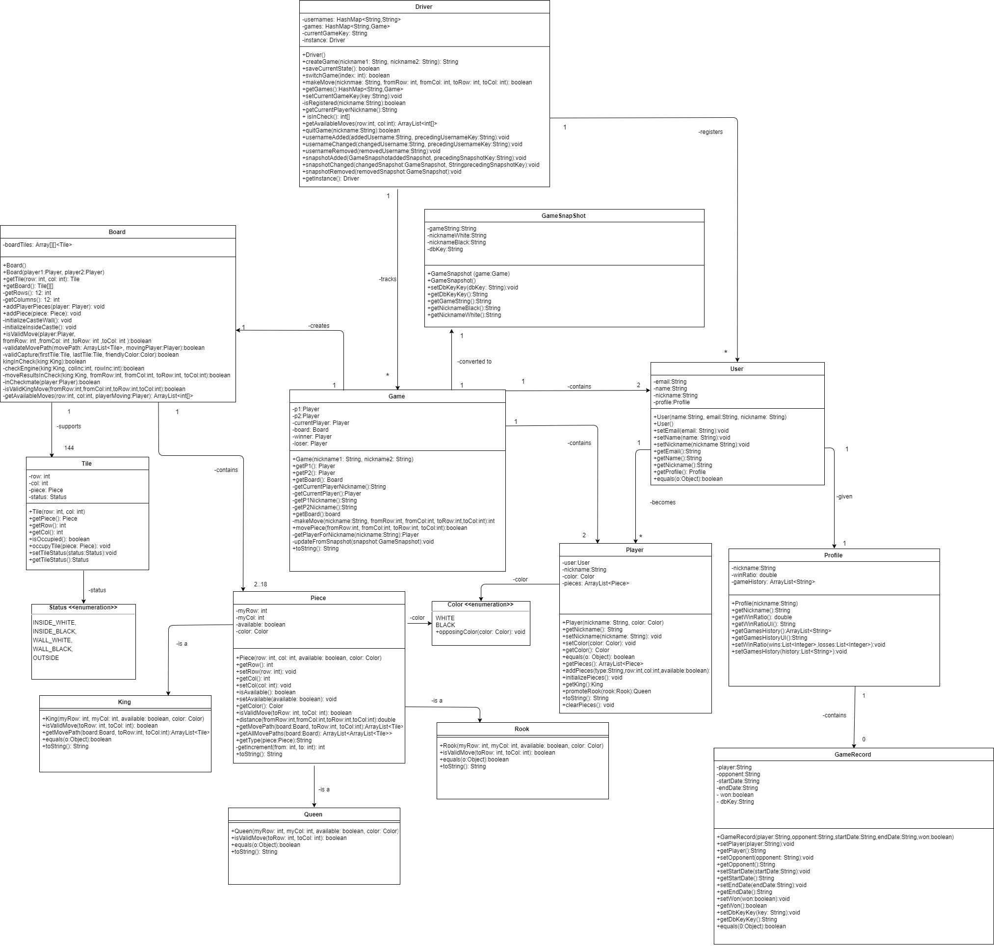
Updated Design Class Diagram

Slide 9
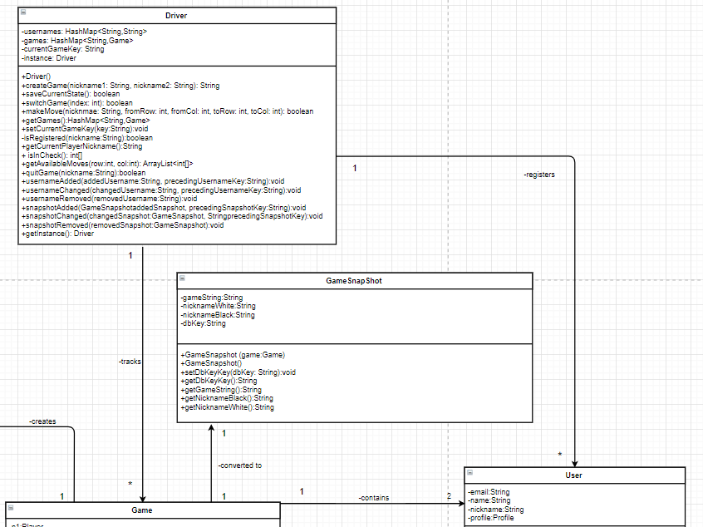
Design Class Diagram
Pt 1

Slide 10
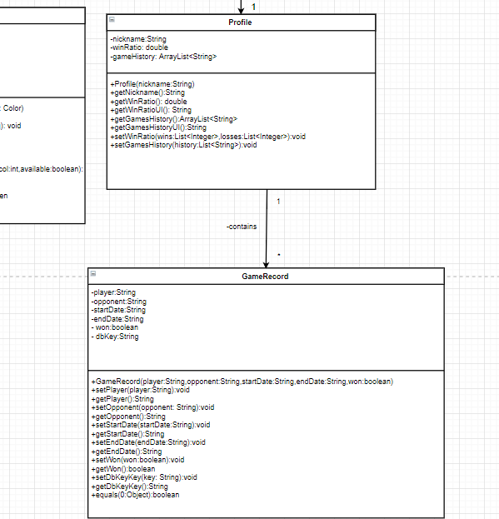
Design Class Diagram
Pt 2

Slide 11
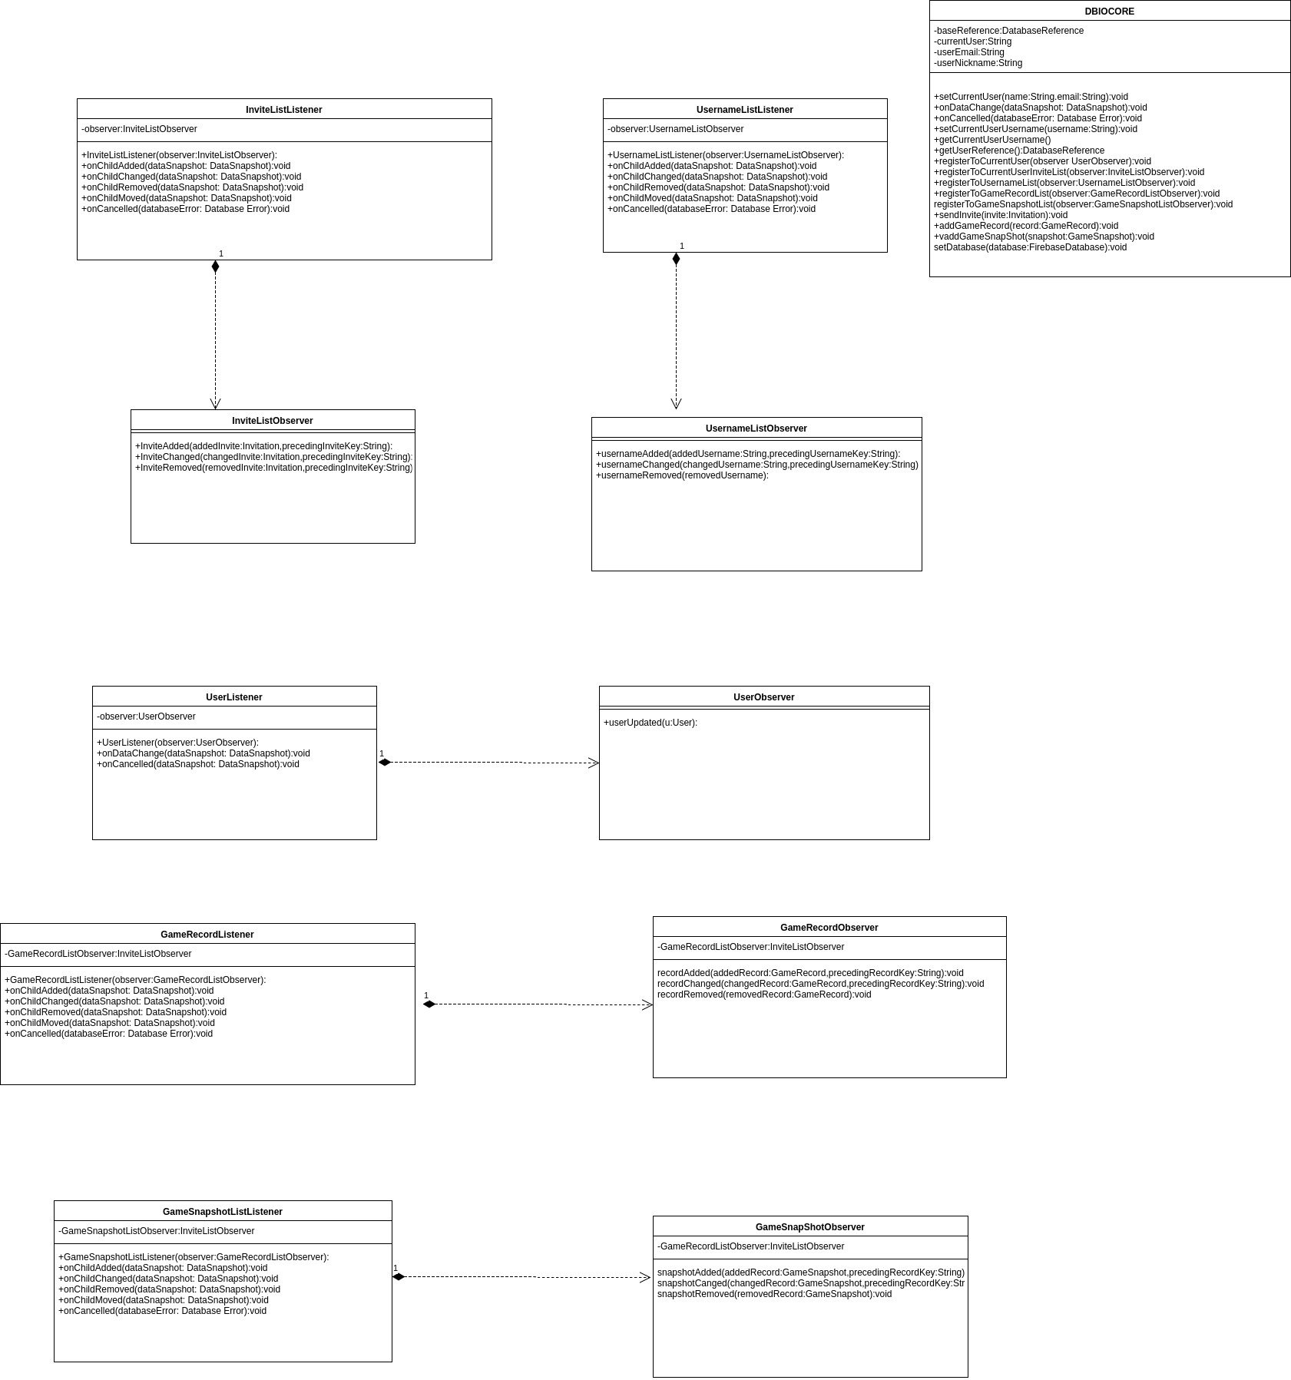
Persistence Diagram

Slide 12
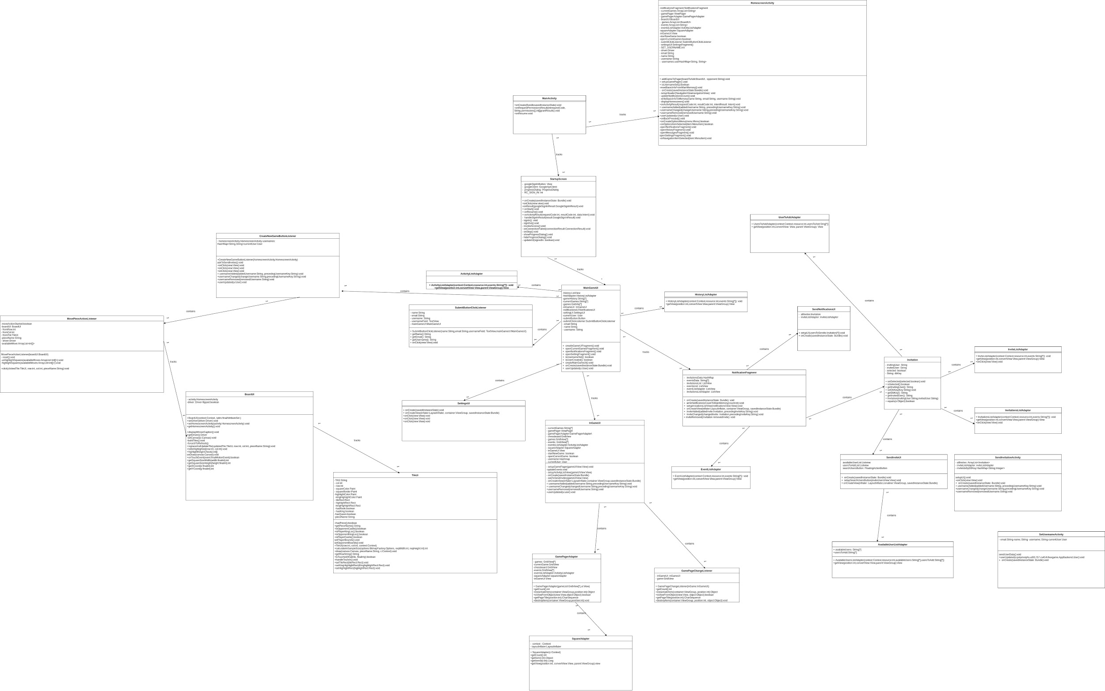
UI Class Diagram

Slide 13
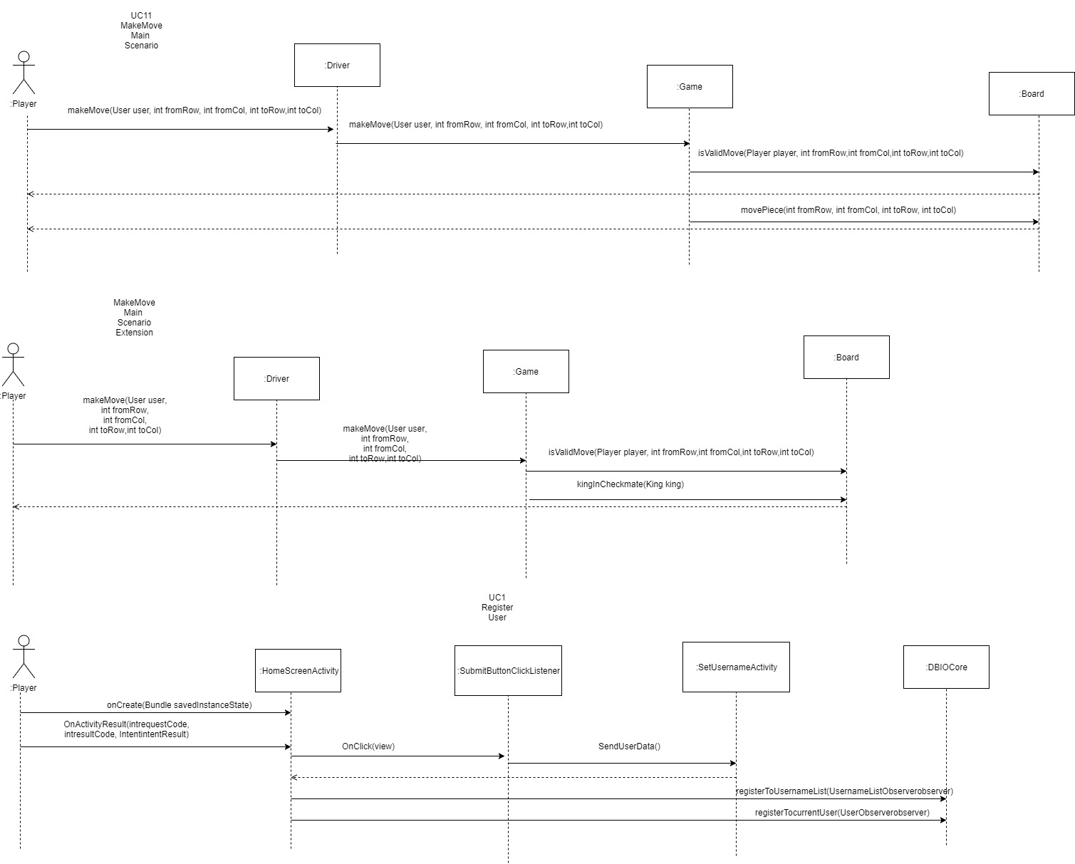
Updated Sequence Diagrams

Slide 14
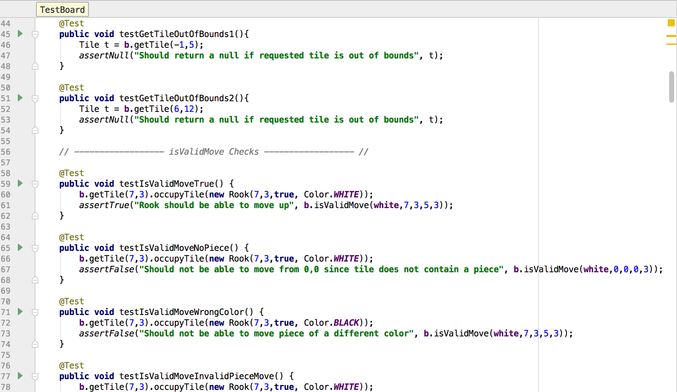
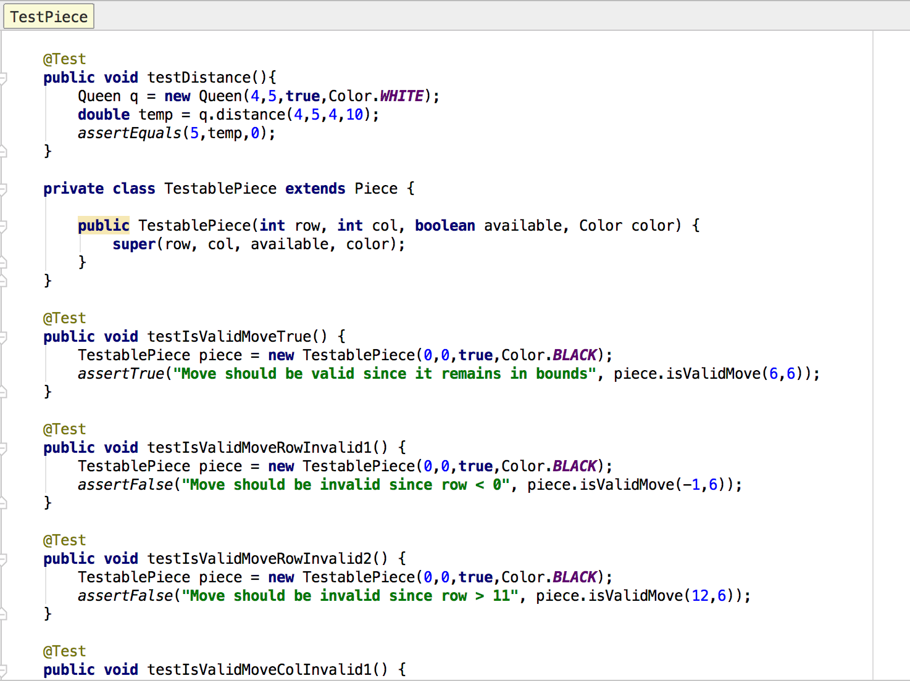
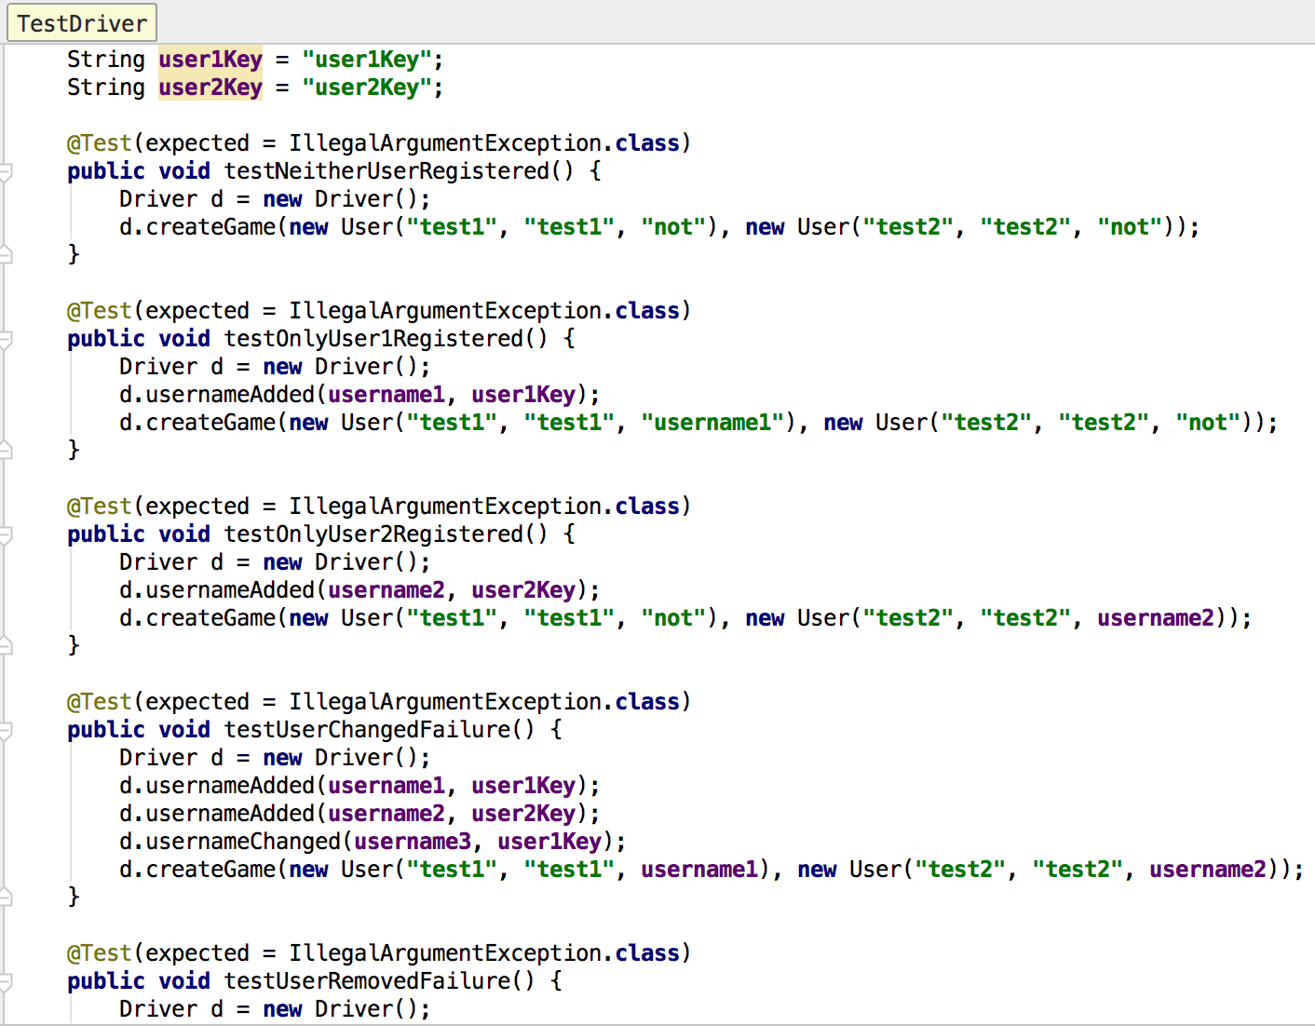
J-Unit testing

Slide 15
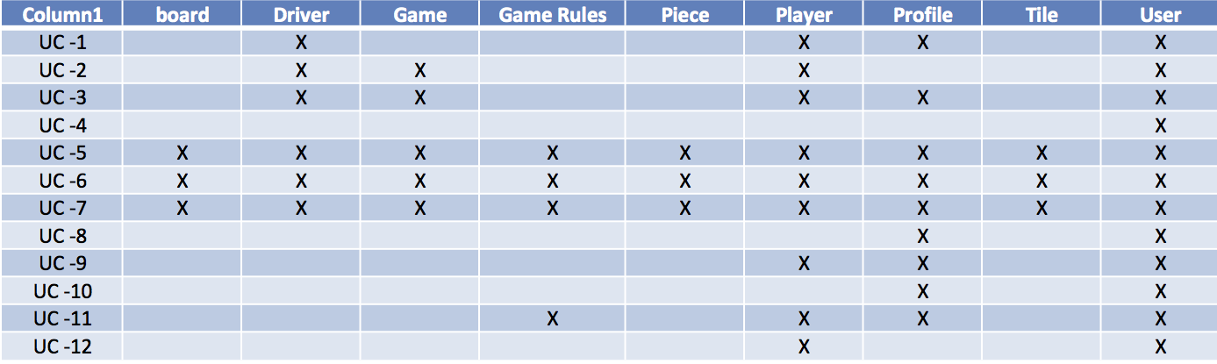
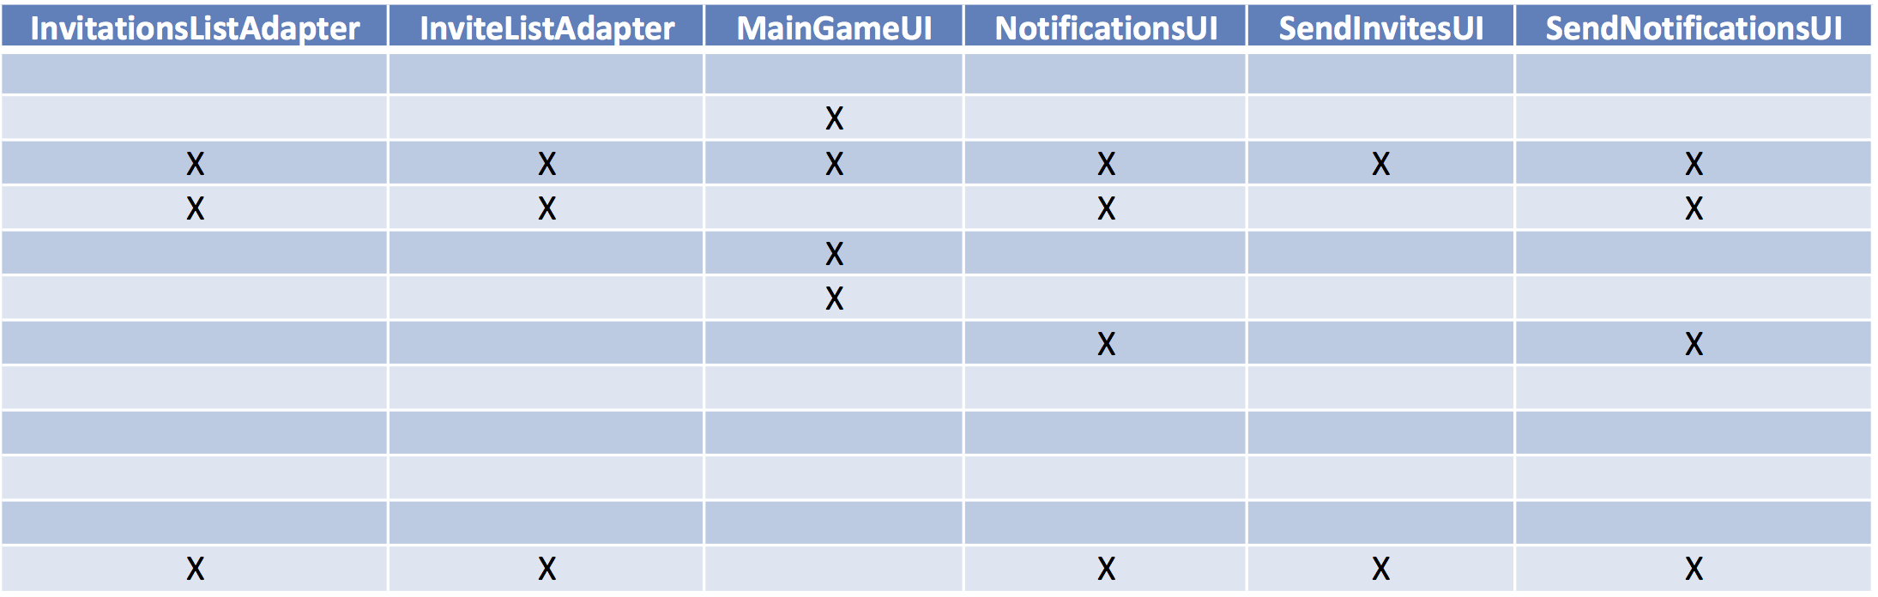
Traceability link Matrix

Slide 16
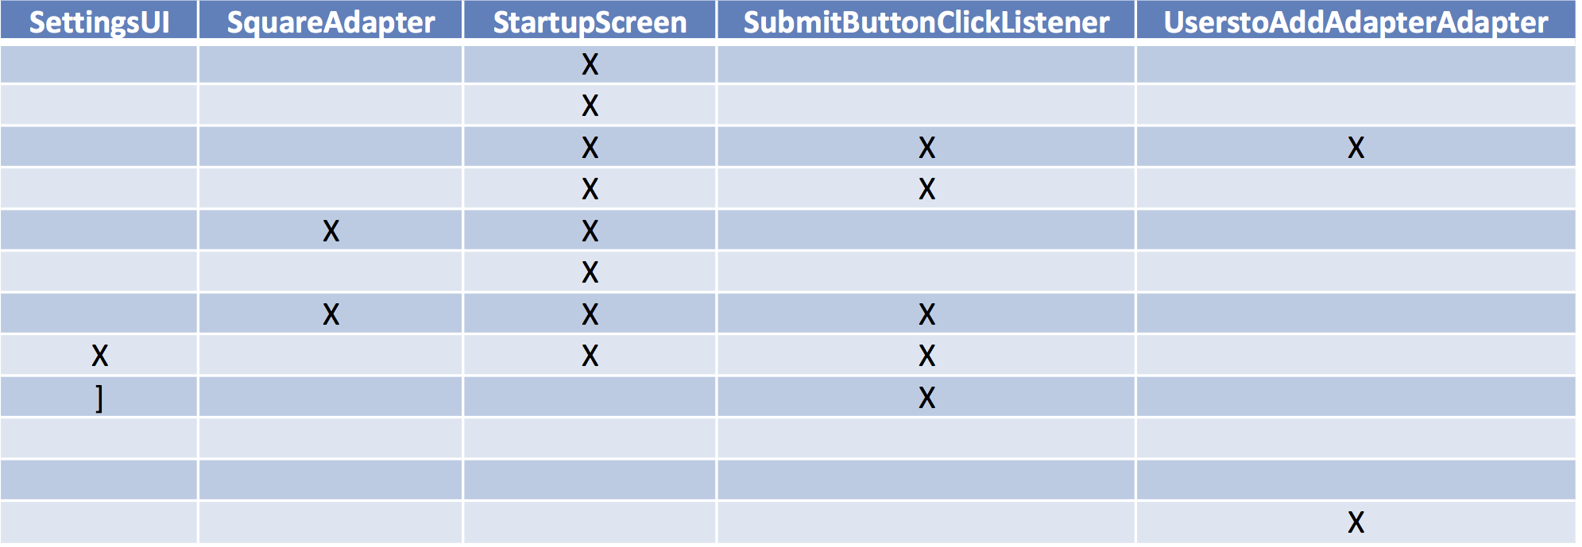
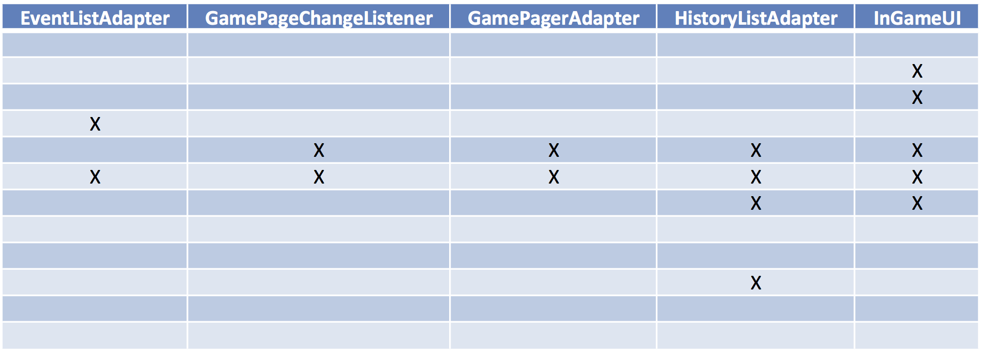
Traceability link Matrix pt II

Slide 17
Refactoring
Both Driver and DBIOCore have been changed to be singletons to ensure only one instance exists
Implemented an observer pattern for database access. For example, stores invitations on Firebase when a user accepts an invitation

Slide 18
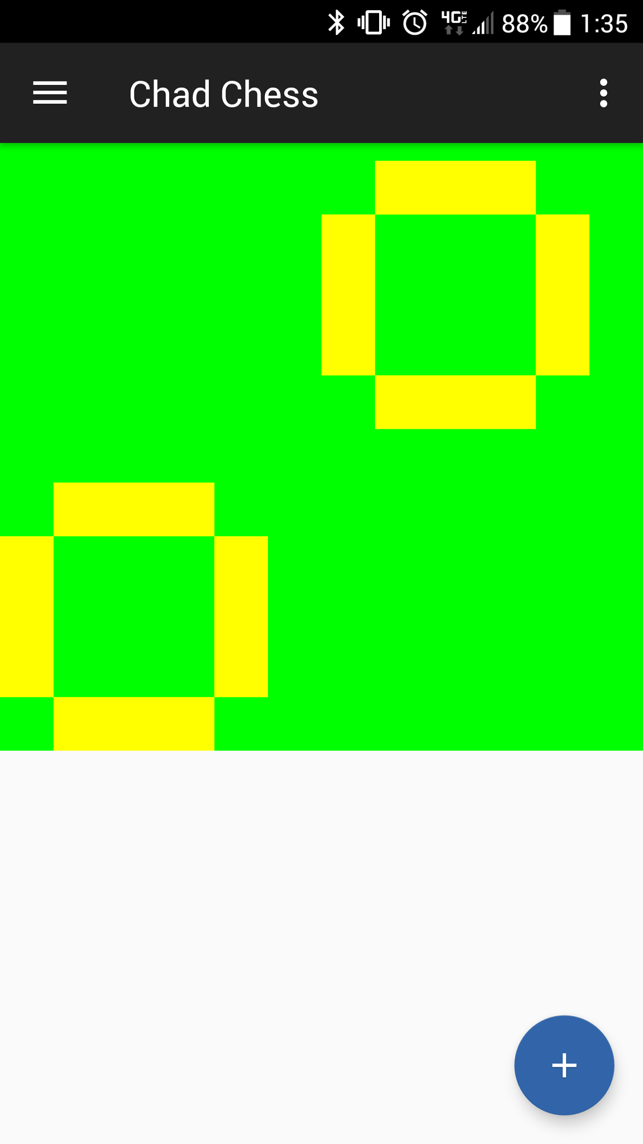
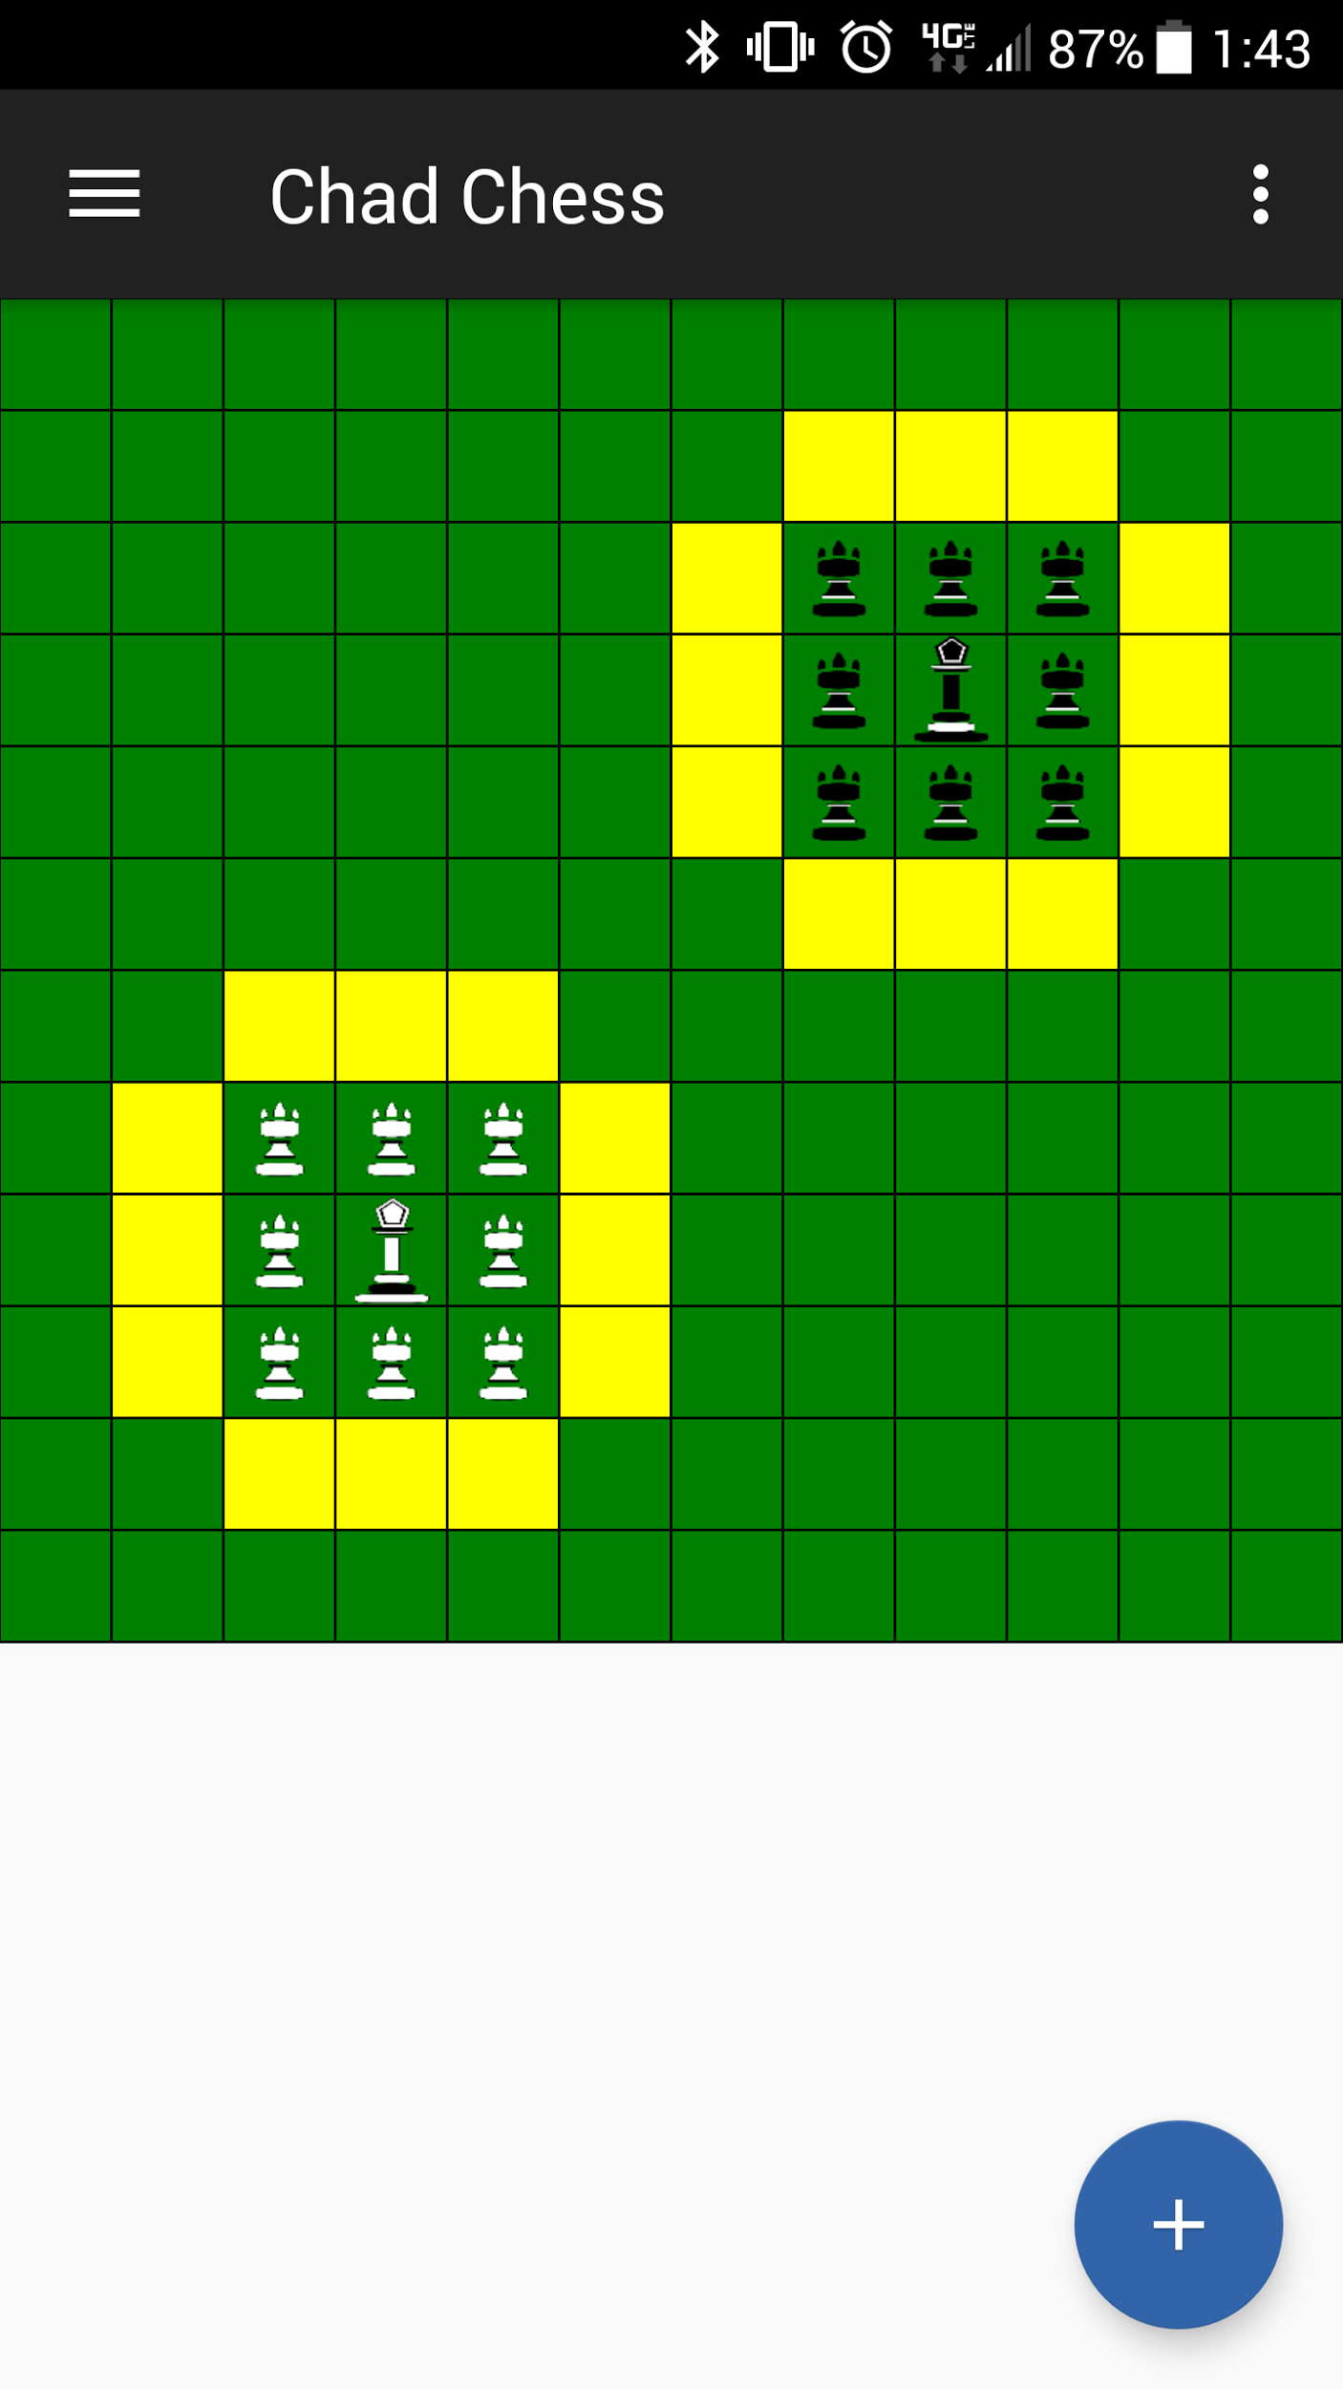
Demo
(Before)
(After)

Slide 19

Thanks!
Any questions?

Slide 20

Credits
Special thanks to all the people who made and released these awesome resources for free:
Presentation template by SlidesCarnival
Photograph by Death to the Stock Photo (license)
Android Photo 1 by ombre.tech
Android Photo 2 by androidpit.com

